Slide 1
LMS Web Project
Developed By –
Sanjay Sherkhane

Slide 2
Development toles used –
-Spring Boot
-MySQL
-Java
Frame work
Spring MVC
Java classes –
User
Admin
Courses
Interfaces -
UserRepo
AdminRepo
CoursesRepo
Controller class -
UserController

Slide 3
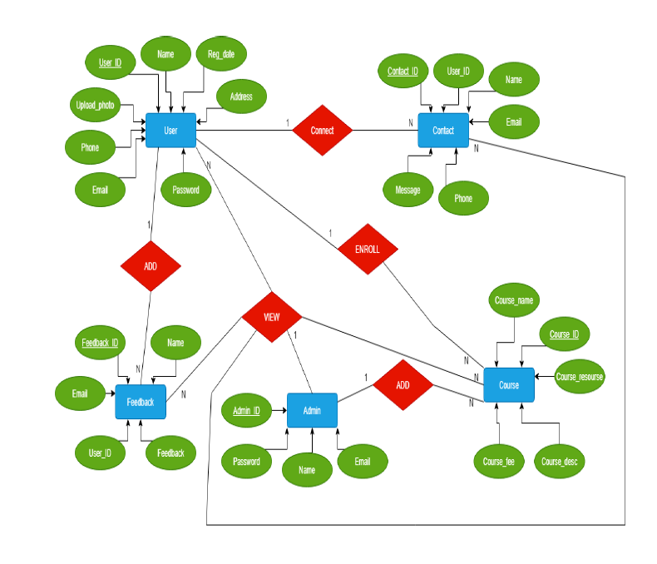
Relation Schema

Slide 4
MySql Configuration –
Database name – Project
Table names –
user
admin
courses

Slide 5
Project Flow-
User –
--> user.java will create tables using hibernate
userRepo.java used for data fetching
Admin –
Admin.java will create tables schema using hibernate
adminRepo.java used for data fetching
Controller class –
UserController.java used to control the all request mapping of front end and backend

Slide 6
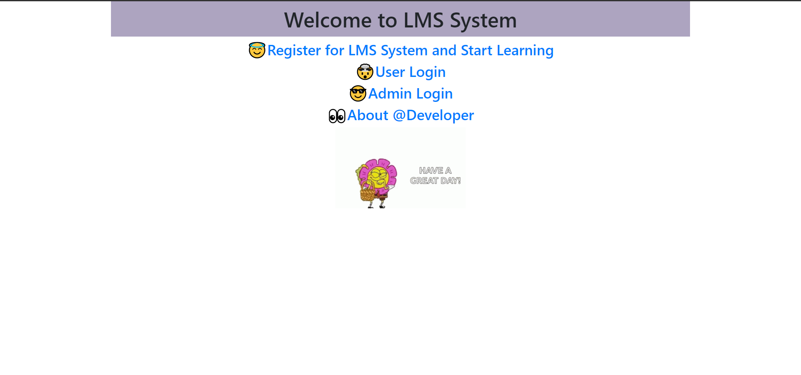
Screen Shots –
Home page

Slide 7
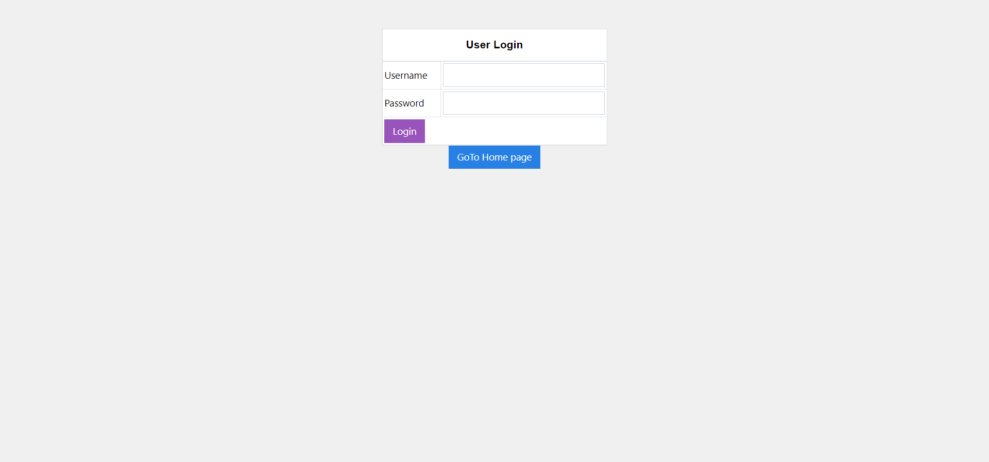
Screen Shots –
User Login

Slide 8
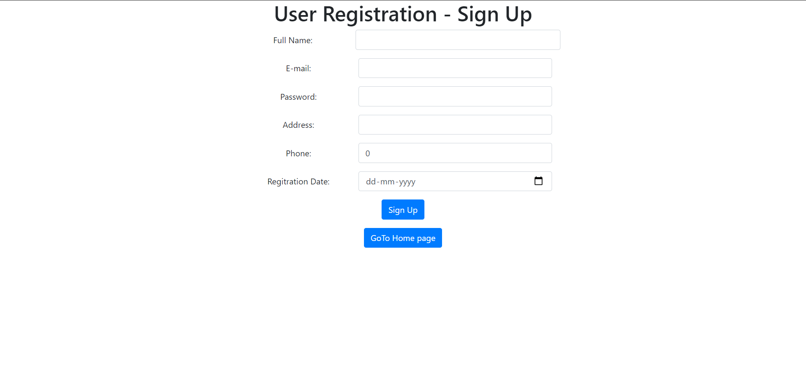
Screen Shots –
User Registration

Slide 9
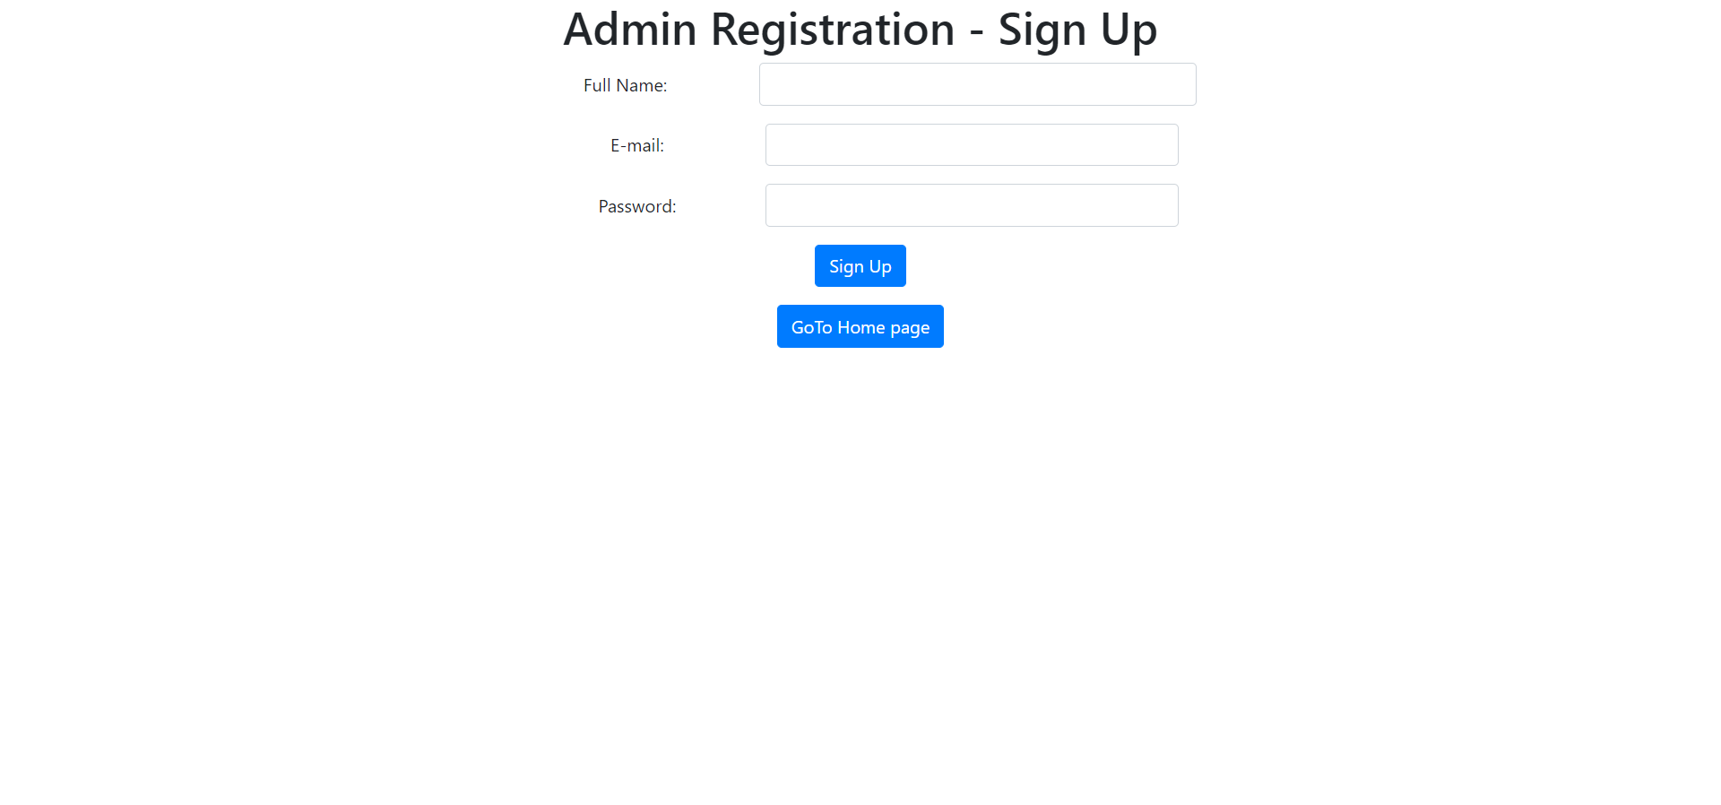
Screen Shots –
Admin Registration

